Slide 1
Winnow & Perceptron
Lee-Ad Gottlieb

Slide 2
Winnow
The winnow algorithm was developed in 1988, for when most of the features of a vector are not relevant.
Assumption: The presence of even one relevant feature implies +.
 | F₁ | F₂ | F₃ | F₄ | label
Person | old | male | tall | resident | Coffee
X₁ | 1 | 0 | 1 | 0 | +
X₂ | 0 | 1 | 0 | 1 | +
X₃ | 1 | 1 | 0 | 0 | -
X₄ | 0 | 1 | 0 | 0 | -

Slide 3
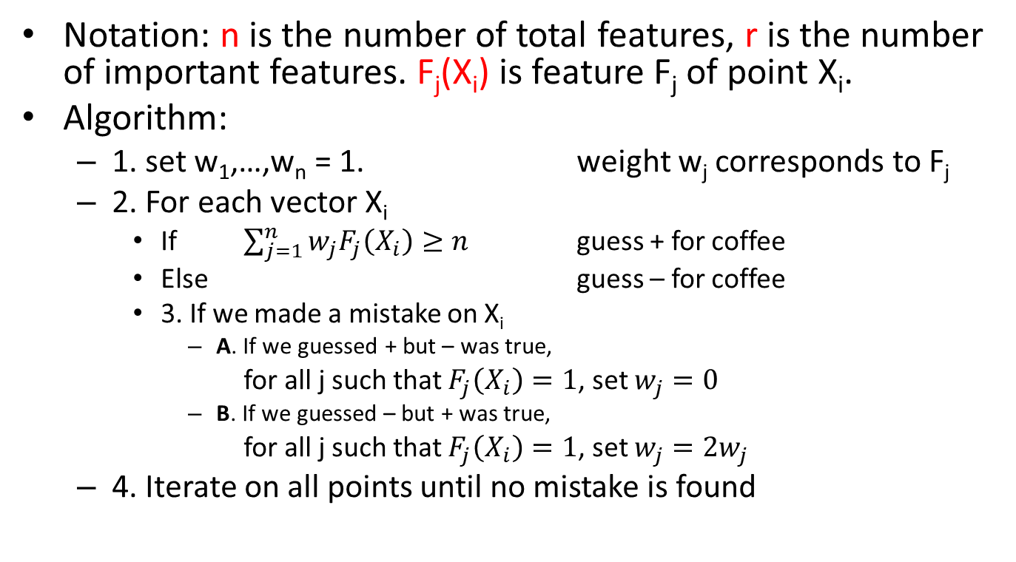
Winnow
Notation: n is the number of total features, r is the number of important features. F_{j}(X_{i}) is feature F_{j} of point X_{i}.
Algorithm:
1. set w₁,…,w_{n} = 1. weight w_{j} corresponds to F_{j}
2. For each vector X_{i}
If $\sum_{j=1}^{n}{{w_{j}F}_{j}\left(X_{i}\right)}≥n$ guess + for coffee
Else guess – for coffee
3. If we made a mistake on X_{i}
A. If we guessed + but – was true,
for all j such that $F_{j}\left(X_{i}\right)=1$, set $w_{j}=0$
B. If we guessed – but + was true,
for all j such that $F_{j}\left(X_{i}\right)=1$, set $w_{j}=2w_{j}$
4. Iterate on all points until no mistake is found

Slide 4
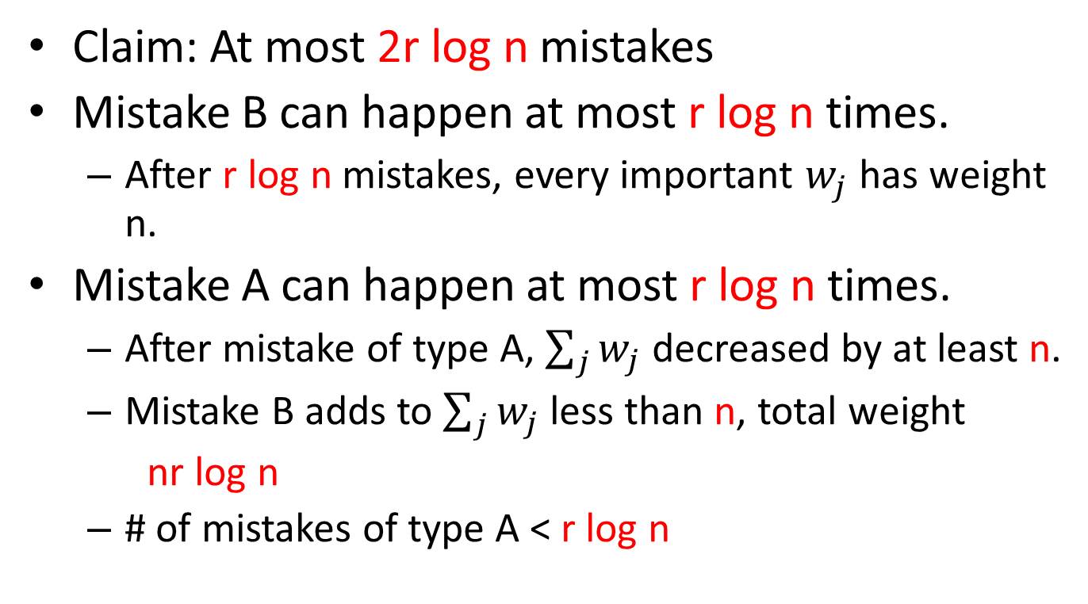
Winnow
Claim: At most 2r log n mistakes
Mistake B can happen at most r log n times.
After r log n mistakes, every important $w_{j}$ has weight n.
Mistake A can happen at most r log n times.
After mistake of type A, $\sum_{j}{w_{j}}$ decreased by at least n.
Mistake B adds to $\sum_{j}{w_{j}}$less than n, total weight
nr log n
# of mistakes of type A < r log n

Slide 5
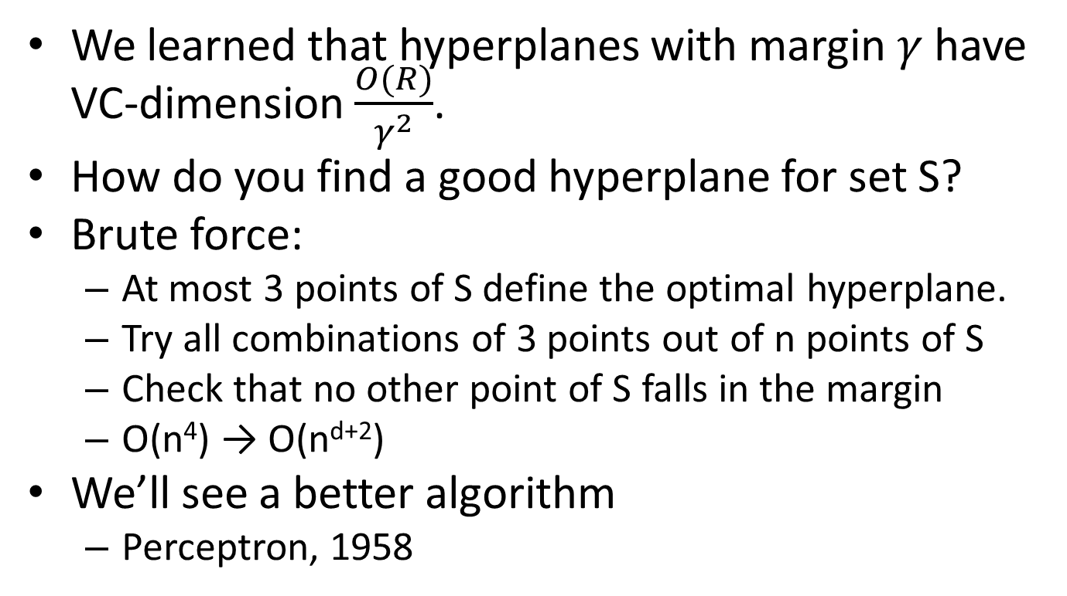
Perceptron algorithm
We learned that hyperplanes with margin $γ$ have VC-dimension $\frac{O(R)}{γ^{2}}$.
How do you find a good hyperplane for set S?
Brute force:
At most 3 points of S define the optimal hyperplane.
Try all combinations of 3 points out of n points of S
Check that no other point of S falls in the margin
O(n⁴) → O(n^{d+2})
We’ll see a better algorithm
Perceptron, 1958

Slide 6
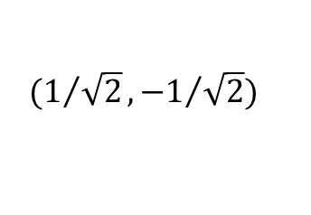
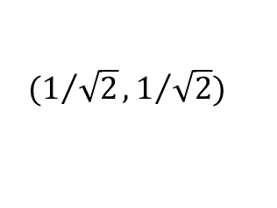
Dot product
Properties of vector dot-product
Equal to cosine
Orthogonal vectors have product 0
Identical normalized vectors have dot product 1
Denote hyperplane using orthogonal vector
For any point, its distance to the line is its dot product with the vector
$$(1/{\sqrt{2}},1/{\sqrt{2}})$$
$$(1/{\sqrt{2}},{−1}/{\sqrt{2}})$$

Slide 7
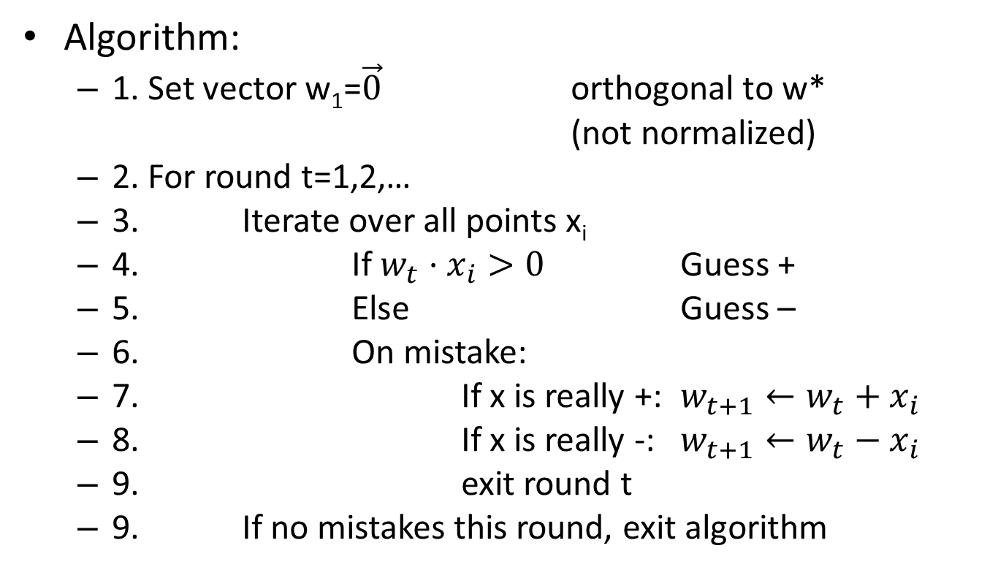
Perceptron
Algorithm:
1. Set vector w₁=$\vec{0}$ orthogonal to w*
(not normalized)
2. For round t=1,2,…
3. Iterate over all points x_{i}
4. If $w_{t}⋅x_{i}>0$ Guess +
5. Else Guess –
6. On mistake:
7. If x is really +: $w_{t+1}←w_{t}+x_{i}$
8. If x is really -: $w_{t+1}←w_{t}−x_{i}$
9. exit round t
9. If no mistakes this round, exit algorithm

Slide 8
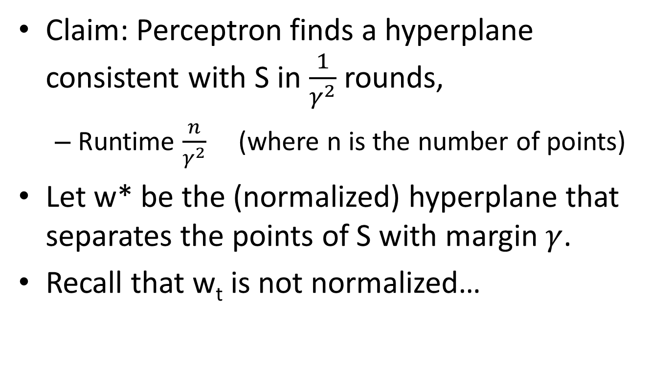
Perceptron
Claim: Perceptron finds a hyperplane consistent with S in $\frac{1}{γ^{2}}$ rounds,
Runtime $\frac{n}{γ^{2}}$ (where n is the number of points)
Let w* be the (normalized) hyperplane that separates the points of S with margin $γ$.
Recall that w_{t} is not normalized…

Slide 9

Perceptron
1. We claim that
w_{t+1}w* ≥ w_{t}w*+ $γ$
This means the vector gets closer to w*
If mistake x is +:
w_{t+1}w* = (w_{t}+x)w*
= w_{t}w* + xw*
≥ w_{t}w* + $γ$
If mistake x is -:
w_{t+1}w* = (w_{t}-x)w*
= w_{t}w* - xw*
≥ w_{t}w* + $γ$

Slide 10
Perceptron
2. We claim that ǁw_{t+1}ǁ² ≤ ǁw_{t}ǁ² +1
This means the vector norm doesn’t get too large
If mistake x is +:
ǁw_{t+1}ǁ² = ǁw_{t} + xǁ²
= ǁw_{t}ǁ² + 2w_{t} x + ǁxǁ²
= ǁw_{t}ǁ² + 2w_{t} x + 1
< ǁw_{t}ǁ² + 1
If mistake x is -:
ǁw_{t+1}ǁ² = ǁw_{t} - xǁ²
= ǁw_{t}ǁ² - 2w_{t} x + ǁxǁ²
= ǁw_{t}ǁ² - 2w_{t} x + 1
< ǁw_{t}ǁ² + 1

Slide 11
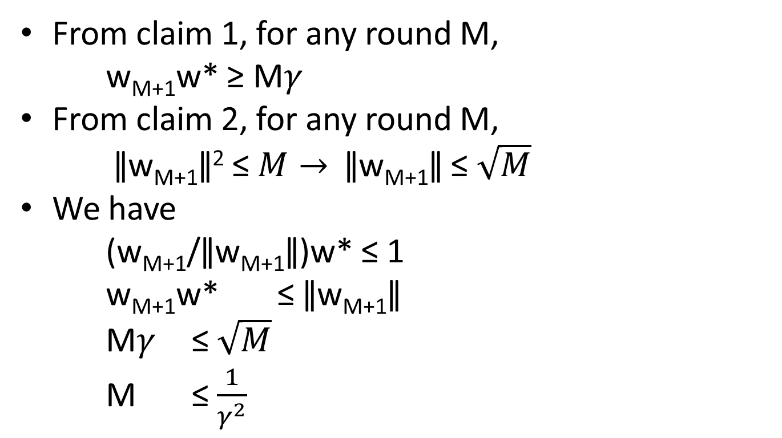
Perceptron
From claim 1, for any round M,
w_{M+1}w* ≥ M$γ$
From claim 2, for any round M,
ǁw_{M+1}ǁ² ≤ $M→$ ǁw_{M+1}ǁ ≤ $\sqrt{M}$
We have
(w_{M+1}/ǁw_{M+1}ǁ)w* ≤ 1
w_{M+1}w* ≤ ǁw_{M+1}ǁ
M$γ$ ≤ $\sqrt{M}$
M ≤ $\frac{1}{γ^{2}}$

